Slide 1
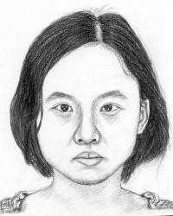
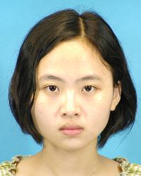
G₀
G₀
...
r
G_{N-1}
G_{N-1}
r
G_{N}
G_{N}

Slide 2
32*64*64
64*64*64
64*32*32
128*32*32
128*16*16
fromRGB
toRGB
x
3*64*64
6*64*64
64*32*32
128*32*32
128*16*16
x
3*64*64
6*64*64

Slide 3
在SinGan的输入中加入photo，使用photo生成sketch

Slide 4
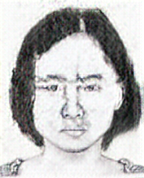
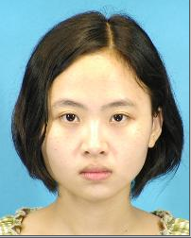
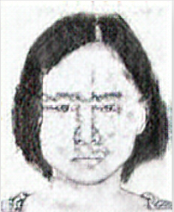
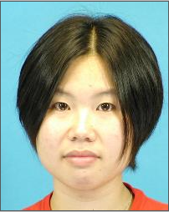
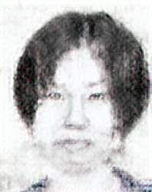
add_p_u_net_4 100epoch
训练
测试

Slide 5
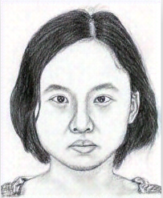
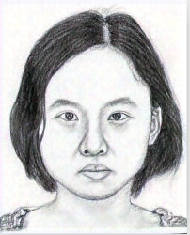
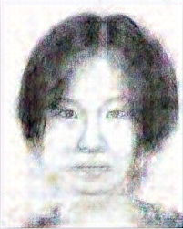
add_p_u_net_4 200epoch
训练
测试

Slide 6
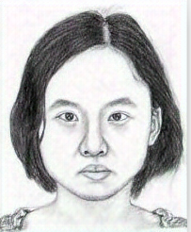
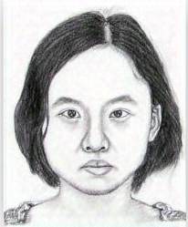
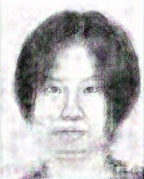
add_p_u_net_4 300epoch
训练
测试

Slide 7
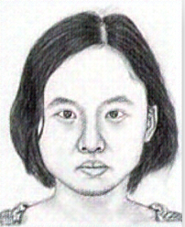
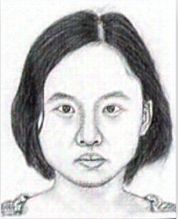
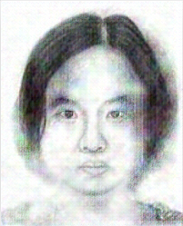
add_p_u_net_6 50epoch
训练
测试

Slide 8
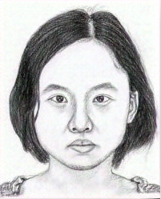
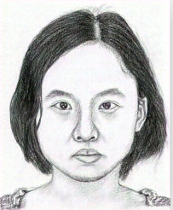
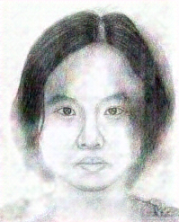
add_p_u_net_6 100epoch
训练
测试

Slide 9
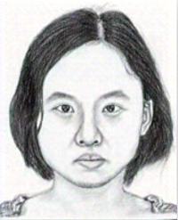
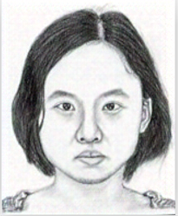
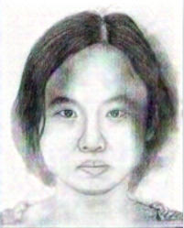
add_p_u_net_8 100epoch
训练
测试

Slide 10
part:1, rank0-rank1:67.3925, rank0-rank2:95.8784
part:2, rank0-rank1:232.4629, rank0-rank2:200.1399
part:3, rank0-rank1:54.5673, rank0-rank2:81.5532
part:4, rank0-rank1:47.6054, rank0-rank2:92.1494
part:5, rank0-rank1:88.1809, rank0-rank2:98.8332
part:6, rank0-rank1:46.0820, rank0-rank2:116.1056
part:7, rank0-rank1:95.9708, rank0-rank2:133.9966
part:8, rank0-rank1:59.3523, rank0-rank2:108.3277
part:9, rank0-rank1:50.3910, rank0-rank2:93.8523
part:10, rank0-rank1:76.2739, rank0-rank2:122.2635
part:1, rank0-rank1:114.6926, rank0-rank2:123.4901
part:2, rank0-rank1:38.7825, rank0-rank2:73.1999
part:3, rank0-rank1:47.0796, rank0-rank2:72.7833
part:4, rank0-rank1:53.1178, rank0-rank2:98.8272
part:5, rank0-rank1:34.9304, rank0-rank2:85.9515
part:1, rank0-rank1:48.2562, rank0-rank2:87.7258
part:2, rank0-rank1:71.3283, rank0-rank2:92.0720
part:3, rank0-rank1:76.6082, rank0-rank2:92.2655
part:4, rank0-rank1:84.6407, rank0-rank2:98.8859
part:5, rank0-rank1:64.5970, rank0-rank2:122.7070
part:1, rank0-rank1:48.6788, rank0-rank2:90.9762
part:2, rank0-rank1:70.0848, rank0-rank2:104.7107
part:3, rank0-rank1:84.3431, rank0-rank2:100.3748
part:4, rank0-rank1:79.1336, rank0-rank2:107.7649
part:5, rank0-rank1:89.7912, rank0-rank2:103.3159
part:6, rank0-rank1:88.4047, rank0-rank2:106.1864
part:7, rank0-rank1:90.1783, rank0-rank2:107.7141
part:8, rank0-rank1:104.2319, rank0-rank2:114.5535
part:9, rank0-rank1:68.8732, rank0-rank2:124.7456
part:10, rank0-rank1:82.5370, rank0-rank2:146.2569
InceptiveV3

